Slide 1
Software Re-Engineering
Lecture No.02
BSSE – 7 & 8
Instructor: Muhammad Usman Shahid

Slide 2
Lecture 2: Content
Software maintenance and evolution

Slide 3
Software Maintenance

Slide 4
Software Maintenance
The ISO/IEC 14764 standard defines software maintenance as
“the set of activities required to provide cost-effective support to a software system. Activities are performed during the pre-delivery stage as well as the post-delivery stage”

Slide 5
Software Maintenance
Pre-delivery activities include planning for post-delivery operations.
Post-delivery activities include changing software, provide training, and operating a help desk.
During the development process, maintainability is specified, reviewed, and controlled.
If this is done successfully, the maintainability of the software will improve during the post-delivery stage.

Slide 6
Software Maintenance
Software maintenance is the capability of the software product to be modified.
Modification may include corrections, improvements or adaptation of the software to changes in environment, in requirements and functional specification”

Slide 7
Software Maintenance
Receiving of a change request from a customer is a kind of event that can trigger software maintenance.
An investigation activity is the first activity in a maintenance process.
In an investigation activity, a maintenance engineer evaluates the nature of the events, say, a change request (CR).
Upon completion of the first activity, the organization decides whether or not to proceed with the modification activity.

Slide 8
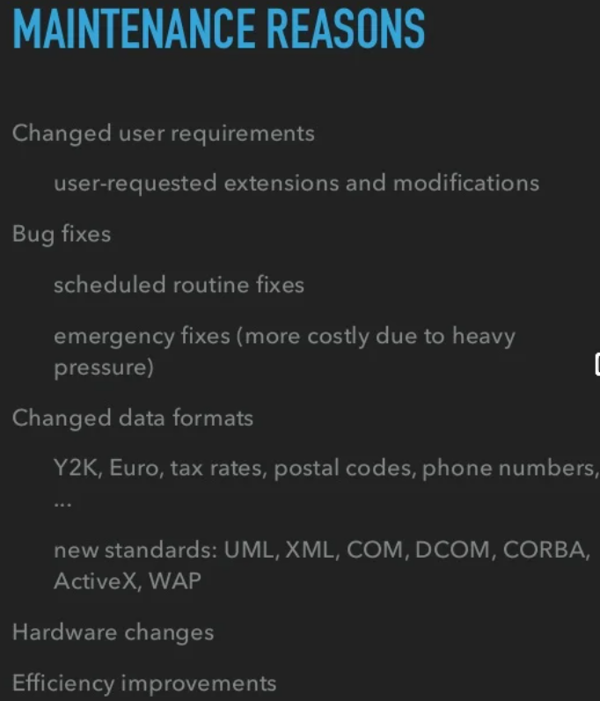

Slide 9
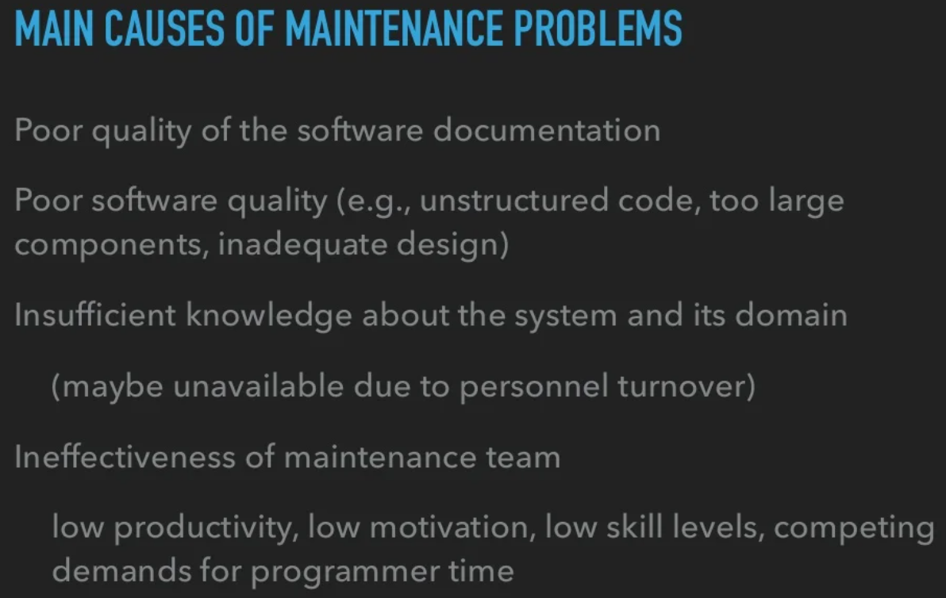

Slide 10
Classification of Software Maintenance Activities
Intention-based classification of software maintenance activities;
Activity-based classification of software maintenance activities; and
Evidence-based classification of software maintenance activities.

Slide 11
Intention-based classification of software maintenance activities;
categorizes maintenance activities into four groups:
1) corrective
2) Adaptive
3) Perfective
4) preventive

Slide 12
Intention-based classification of software maintenance activities;
Corrective maintenance
to correct failures: 1) processing failures and 2) performance failures.
A program producing a wrong output is an example of processing failure
a program not being able to meet real-time requirements is an example of performance failure.
The process of corrective maintenance includes isolation and correction of defective elements in the software.

Slide 13
Intention-based classification of software maintenance activities;
Corrective maintenance
The software product is repaired to satisfy requirements.
Basically, corrective maintenance is a reactive process, which means that corrective maintenance is performed after detecting defects with the system.

Slide 14
Intention-based classification of software maintenance activities;
Adaptive maintenance
to enable the system to adapt to changes in its data environment or processing environment
This process modifies the software to properly interface with a changing or changed environment.
Adaptive maintenance includes system changes, additions, deletions, modifications, and improvements to meet the evolving needs of the environment in which the system must operate.

Slide 15
Intention-based classification of software maintenance activities;
Adaptive maintenance
Some generic examples are:
Changing the system to support new hardware configuration;
Changing the system to be compatible with other applications.
A more concrete example is, an application software on a smartphone can be enhanced to support WiFi-based communication in addition to its present 3G cellular communication.

Slide 16
Intention-based classification of software maintenance activities;
Perfective maintenance
The purpose of perfective maintenance is to make a variety of improvements namely; user experience, processing efficiency, and maintainability.
For example, the program outputs can be made more readable for better user experience;
the program can be modified to make it faster, thereby increasing the processing efficiency;

Slide 17
Intention-based classification of software maintenance activities;
Perfective maintenance
and the program can be restructured to improve its readability, thereby increasing its maintainability.
In general, activities for perfective maintenance include restructuring of the code, creating and updating documentations, and tuning the system to improve performance.
It is also called “maintenance for the sake of maintenance” or “reengineering”

Slide 18
Intention-based classification of software maintenance activities;
Preventive maintenance
The purpose of preventive maintenance is to prevent problems from occurring by modifying software products.
Basically, one should look ahead, identify future risks and unknown problems, and take actions so that those problems do not occur
Preventive maintenance is very often performed on safety critical software systems

Slide 19
Intention-based classification of software maintenance activities;
Preventive maintenance
The concept of “software rejuvenation” is a preventive maintenance measure to prevent, or at least postpone, the occurrences of failures due to continuously running the software system
Software rejuvenation is a fault management technique aimed at cleaning up the system’s internal state to prevent the occurrence of more severe crash in the future.
It involves occasionally terminating an application or a system, cleaning its internal state, and restarting it.
* rejuvenation: reconstruction/ renovation

Slide 20
Intention-based classification of software maintenance activities;
Preventive maintenance
In a safety critical environment, the necessity of performing preventive maintenance is evident from the example of control software for Patriot missile:
“On 21 February, the office sent out a warning that ‘very long running time’ could affect the targeting accuracy.
The troops were not told, how many hours ‘very long’ was or that it would help to switch the computer off and on again after 8 hours.”

Slide 21
Activity-Based Classification of Software Maintenance
corrections and enhancements
Corrections. Activities in this category are designed to fix defects in the system, where a defect is the difference between the expected behavior and the actual behavior of the system.
Enhancements. Activities in this category are designed to effect the changes to the system. The changes to the system do not necessarily modify the behavior of the system.

Slide 22
Activity-Based Classification of Software Maintenance
Enhancements:
This category of activities is further divided into three subcategories as follows:
– enhancement activities that modify some of the existing requirements implemented by the system;
– enhancement activities that add new system requirements
– enhancement activities that modify the implementation without changing the requirements implemented by the system.

Slide 23
Software Evolution

Slide 24
Evolution
To make someone or something change and develop gradually

Slide 25
Software Ageing
Programs like people get old.
We can not prevent ageing, but we can understand its causes, take steps to limit its effects, and prepare for the day when the software is no longer practical.

Slide 26
Reasons why software ages?
Maintenance activities
insufficient or inconsistent documentation
deadline pressure
Lack of modularity

Slide 27
Change is inevitable (unavoidable)
New requirements emerge when software is being used.
Business environment change
New computers and equipment are added to the system
The performance or reliability of the system may have to be improved
New technology (new standards, new OS, new software versions)

Slide 28
Change induces technical debt
As a change is started on a software system, often there is need to make other coordinated changes at the same time in other parts of the software.(Dependent Requirements)

Slide 29
Change is hard to anticipate
Many changes can not be do in advance at design time.

Slide 30
Maintenance Vs. Evolution
Software maintenance typically does not involve major changes to the system’s architecture.
Changes are implemented by modifying existing components and adding new components to the system.
Software evolution is a broader term that encompasses both software maintenance and bigger changes at different phases of the software life-cycle.
Evolution is basic to the nature of software development.

Slide 31
Software Evolution
Evolution may arise
1) During software development
Where the design evolves and matures as the understanding of the problem and how to solve it, gradually increases.
2) During software maintenance
After deployment, in the continuing process of adapting the system to the changing needs of its users and usage environment

